Slide 1
System architect and beyond
Hao Zhong
Shanghai Jiao Tong University

Slide 2
Last class
Doman expert
Requirement Engineering
Concepts
Definition
Stakeholders
Types of requirements
Process
Elicitation
Analysis
Specification
Validation

Slide 3
The cost to fix a problem
Stage
.5 - 1
Requirements Time
2.5
Design
Stage discovered | Relative repair cost (p.day)
Requirements | 0.1 – 0.2
Design | 0.5
Coding | 1
Unit test | 2
Acceptance test | 5
Maintenance | 20
5
Coding
10
Unit Test
25
Acceptance Test
100
Maintenance

Slide 4
Requirement
RUP: A requirement describes a condition or capability to which a system must conform; either derived directly from user needs, or stated in a contract, standard, specification, or other formally imposed document.
UML: A desired feature, property or behavior of the system.

Slide 5
Types of requirements
Functional
What is the system supposed to do
Mapping from inputs to outputs
Non-functional (quality)
Performance
Resource Consumption
Usability
Reliability
Robustness
Portability
…

Slide 6
Requirements engineering process
Elicitation
Analysis
Specification
Validation

Slide 7
Requirements specification
Document what is required of the system to be developed
State the requirements from the perspective of the developers
Natural Language Specification
Structure Specification
Graph Notation Specification
Mathematical Specification
Formal

Slide 8
Software process models
Requirements
engineering
Design
Implementation
Integration
The waterfall model

Slide 9


Role
Systems architects define the architecture of a computerized system (i.e., a system composed of software and hardware) in order to fulfill certain requirements. Such definitions include: a breakdown of the system into components, the component interactions and interfaces (including with the environment, especially the user), and the technologies and resources to be used in the design.
CEO->architect

Slide 10
What is software architecture
Software architecture is the structure of a software system – like the blue prints in building architecture
Software components
Details (data structure and algorithms) hidden
Relationships among the components
Relations can be vague
Data flows
Control flows
Dependencies

Slide 11
Modularity
“Modularity is the single attribute of software that allows a program to be intellectually manageable.” (Bertrand Myers)
Split a larger program into smaller modules
Cohesion - Each module should do one thing - high cohesion
Coupling - Each module should have a simple interface - low coupling
Each module should hide a design decision from others

Slide 12
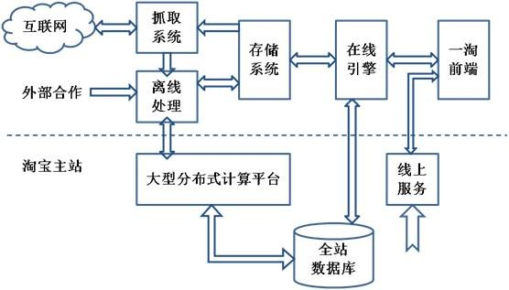
The architecture of www.etao.com

Slide 13
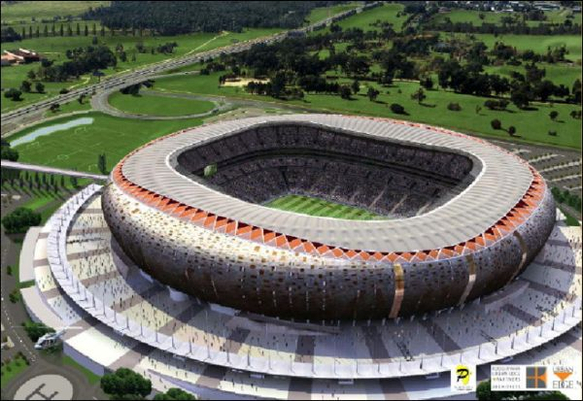
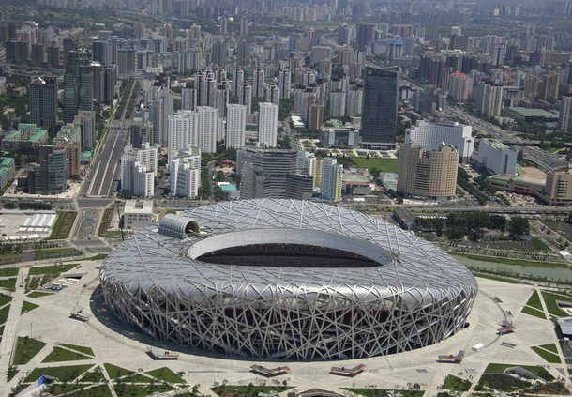
Architecture styles
Stadium

Slide 14
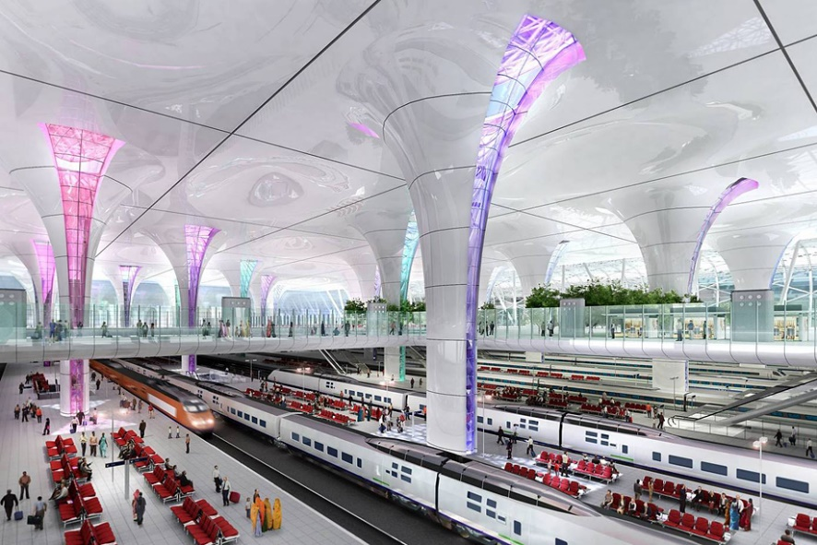

Architecture styles
Stations and airports

Slide 15
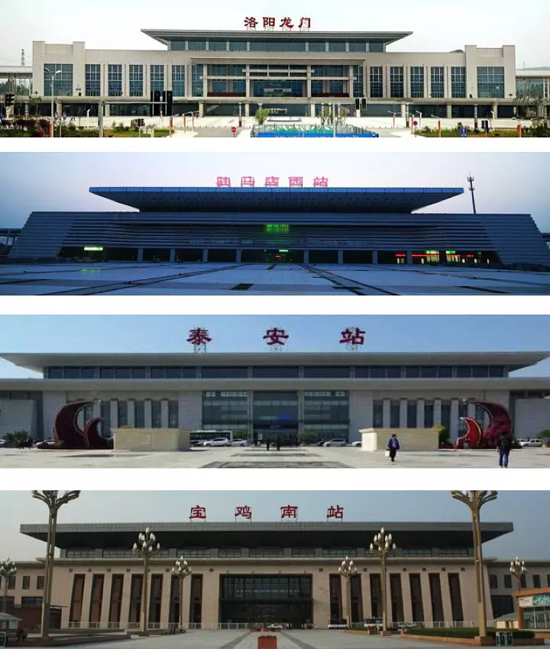
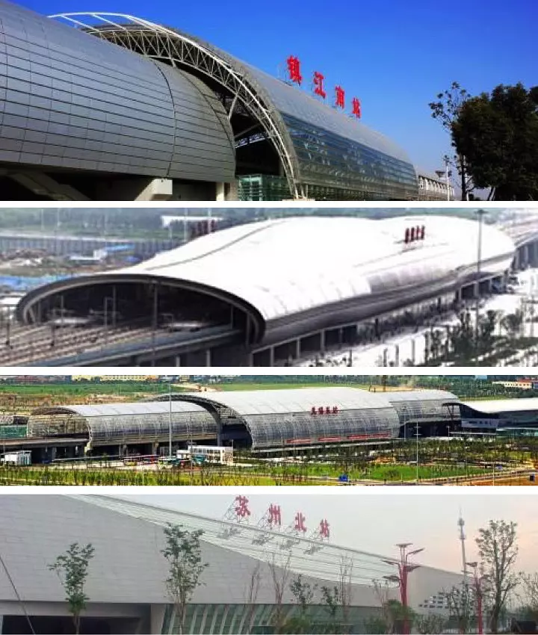
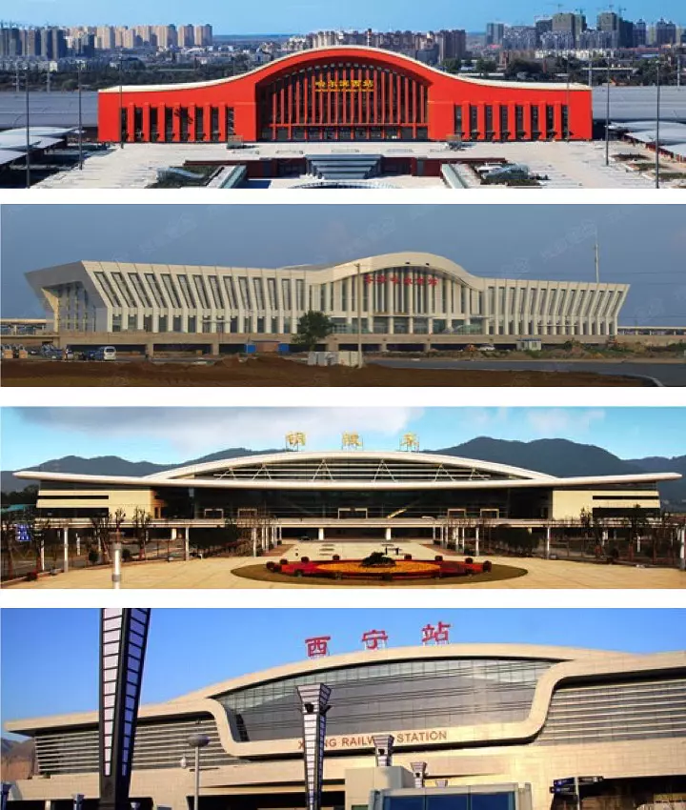
Architecture styles

Slide 16
Why Software architecture styles
Easier to do high level design
People may have tried different styles and found this best (It is not as obvious as for buildings)
The drawbacks of commonly used architectures are well studied
Application
Service
Data

Slide 17
Popular architecture styles
Pipe and Filter
Layered
Repository
MVC

Slide 18
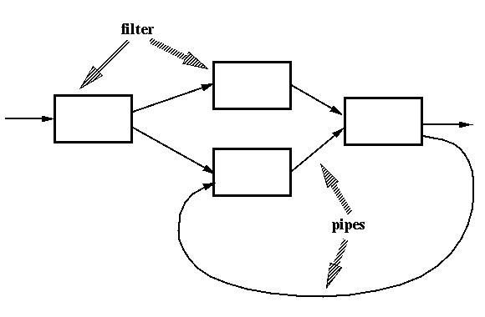
Pipe and Filter
A defined series of independent computations
Performed for data transformation
Compilers: the phases in the pipeline include:
Lexical analysis
Parsing
Semantic analysis
Code generation

Slide 19
Pipe and Filter
Advantages
Easy to understand the overall input/output behavior of a system as a simple composition of the behaviors of the individual filters
They support reuse, since any two filters can be hooked together, provided they agree on the data that is being transmitted between them.
Systems can be easily maintained and enhanced, since new filters can be added to existing systems and old filters can be replaced by improved ones.
The naturally support concurrent execution: map-reduce is actually pipe and filter architecture
Disadvantages
Not good for handling reactive systems, because of their transformational character.
Excessive parsing and un-parsing leads to loss of performance and increased complexity in writing the filters themselves.

Slide 20
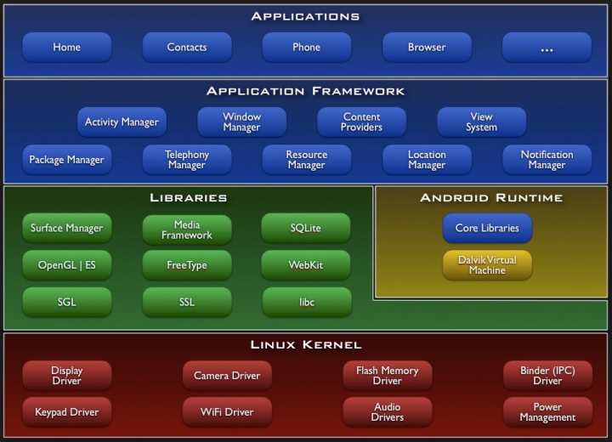
Layered Style
Components: are typically collections of procedures.
Connectors: the layer margin, are typically procedure calls under restricted visibility.
Layer Communication Rules:
Usually a component will talk only with the layer just beneath it
Only carefully selected procedures from the inner layers are made available (exported) to their adjacent outer layer
Operating Systems

Slide 21
Layered Style
Advantages
Design: based on increasing levels of abstraction
Maintainability: changes to the function of one layer affects at most two other layers
Reuse: different implementations (with identical interfaces) of the same layer can be used interchangeably
Disadvantages
Not all systems are easily structured in a layered fashion
Performance requirements may force the coupling of high-level functions to their lower-level implementations

Slide 22
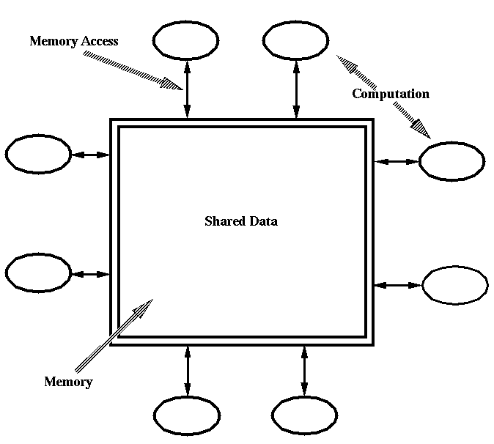
Repository Style
Components:
A central data structure representing the correct state of the system
A collection of independent components that operate on the central data structure
Connectors:
Typically procedure calls or direct memory accesses
Integrated Development Environment (IDE)

Slide 23
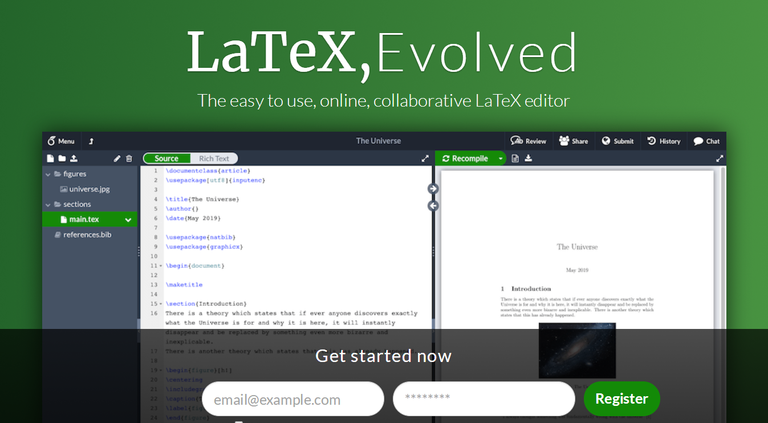
Repository Style
Advantages
Efficient way to store and analyze large amounts of data
Centralized management
Disadvantages
Must agree on a data model a prior
Difficult to distribute data
Data evolution is expensive

Slide 24

MVC Style
View
Little logic; just display info
JSPs; one-to-one mapping to action class (from controller)
Model
Logic related to persistent storage
DB system
Controller
Handle all logic
Action classes

Slide 25

MVC Style

Slide 26
Design decisions
Representation of data
Use of a particular software package
Use of a particular printer
Use of a particular operating system
Use of a particular algorithm
…

Slide 27
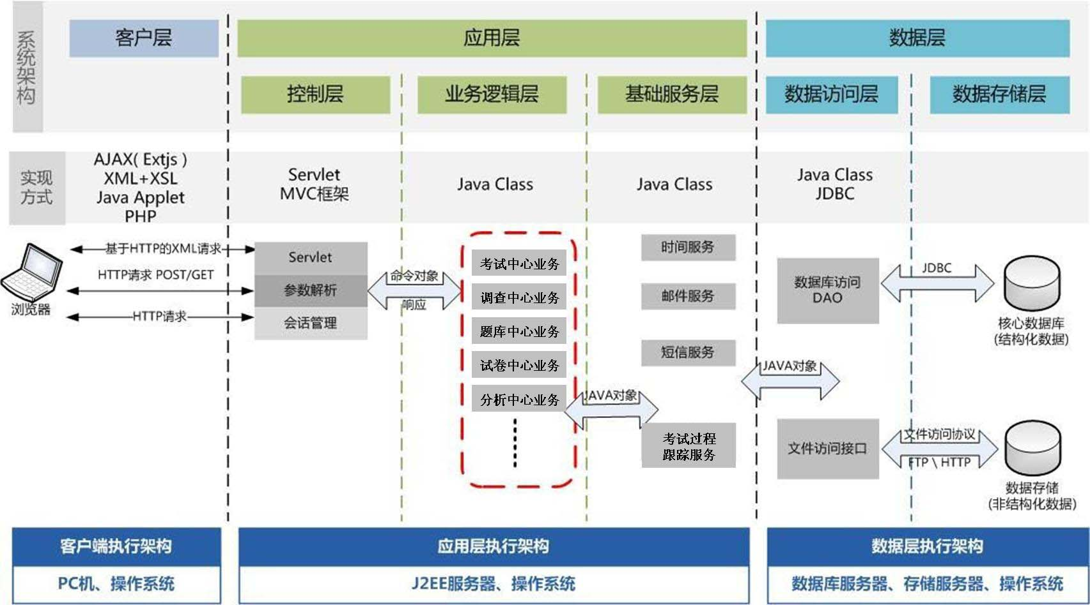
An example

Slide 28
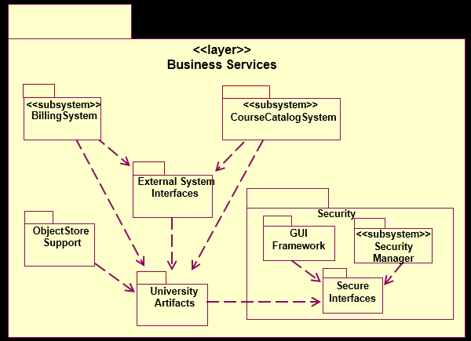
Tool support – Rational rose
<<layer>>
Application
<<layer>>
Business
Services
<<layer>>
Middleware

Slide 29
Software market models
Many more type of software than before:
commercial
contract
shareware
open source
Influences:
commercial needs
IP protection & licensing
support

Slide 30
Commercial
Classical model
MS office
Time
Software as a service (Saas)
Number of computers
Windows
Number of IP addresses
Server
Number of simultaneous users
CAD

Slide 31
Contract
Customized software
ERP
Consulting – individually or through consulting houses, e.g., IBM, Accenture, 金蝶，中软
“Work for hire” – output belongs to customer
Billed by project or by hour

Slide 32
Shareware
Try before you buy
Winzip
Not open source
Freely download binaries
Limited functionality vs full functionality
Tool support/guarantee
In-app purchase
Most games

Slide 33

Open source
Donation
Apache foundation
Like shareware
MySQL
Service
Open office
Advertisement, Patent fee
Android

Slide 34
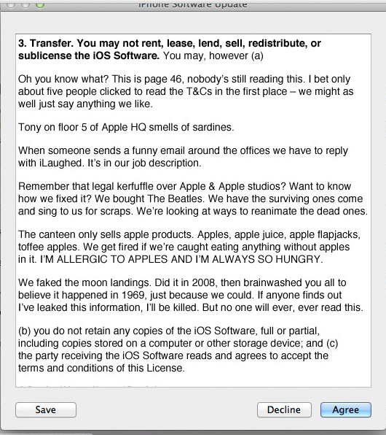
Software license
What is a license
A document accompanying with the software about an agreement of the user’s rights for using or doing other things to the software
For proprietary software
End-user license agreements (EULAs)
For open source software
GPL / LGPL
Apache
BSD
MIT

Slide 35
Why licenses?
The specialty of software, compared to other publications
You often have to copy the software to use it, consider a multiple-CD/floppy disk game, hardware disposal, …
Section 117 of copyright Act: the owner of a software copy have the rights to copy the software to a computer for using purpose
General principle of copyrights: the owner of a copy can resell the copy without the agreement of the copyright owner: resell a book
So, basically, you can copy the software from the CD to your computer, and resell the CD…

Slide 36
Why licenses?
We sell licenses, not software copies
So the users are not “owners of copies”
And they do not have the rights from section 117 of the Copyright Act
They only have the rights described in the license
That’s how software licenses come
A lot of legal issues, and cases
Apple vs. Franklin
…

Slide 37
Software licenses in companies
If you work for a software company
As a developer, ask the department of legal issues before
Using any new tools for your software development, e.g., editing, checking, analysis, visualization, version control, …
Incorporating any code, or using any third-party library in the software you are developing
Especially careful about free and open source software
As a manager
May further need to consider what license to buy, how many to buy, according to the permissions in the licenses
How to design the license of your product

Slide 38
Proprietary licenses
A agreement on how users can use the software
Who can use
certain person, the buyer: personal software
Any personal in a company/org: business software
How many users
1 installation
Fixed number of installations
Contract licenses
Period
Permanent
Annual

Slide 39
License mechanisms
License keys
Server authentication
Hardware ID authentication after the first usage
Protecting the Licensing mechanism
Code obfuscation
Dynamic loaded code
encrypted code

Slide 40
Open source licenses
A document accompany with the source code of open source software
Documenting the rights and responsibility of users or adapters
Users are required to accept the license before using the software
But usually, there is no mechanism to guarantee it
User responsibilities
Announce changes
Include license when re-distribute
Use certain license
Providing revised source code

Slide 41
GPL (General Public License)
Most widely used license
About 45% all open source projects according to Black Duck
GNU software
gcc, glibc, emacs, …
Linux kernel
MySQL
Responsibilities
Providing source code when re-distribute
Re-distribute (any code including or revised from GPL licensed code) under GPL license
Ignore patents and regional rules (liberty or death)
So what will happen if I want to revise a GPL-licensed software, and then sell the revised software?

Slide 42
LGPL (Lesser-GPL)
A variant of GPL
Mostly the same with GPL
Dynamic and static link to LGPL libraries will not enforce your software to be LGPL
Who is using LGPL
QT
KDE
OpenOffice (once)
JBoss

Slide 43
BSD
A license used for Berkeley Software Distribution (Free BSD operating system)
Responsibilities:
When re-distribution:
Including a copyright notice (both source and binary distributions)
Including an acknowledgement in ads
Needs permission
Who is using BSD?
Free BSD operating system
Google Chrome
OpenSSH
Bzip

Slide 44
Apache
A license proposed by apache software foundation
Responsibilities
Include apache license in the distributed software (both source and binary)
State changes in the changed source files
Including of the notice file if the Apache software you use includes one
Who is using apache?
Apache software foundation
Ant, maven, log4j, tomcat, …
OpenOffice (now)
Android system
Most open-source android apps

Slide 45
This class
Software architect
Typical architect styles
Modularity
Design decisions
Tool support
Software market model
License

Slide 46
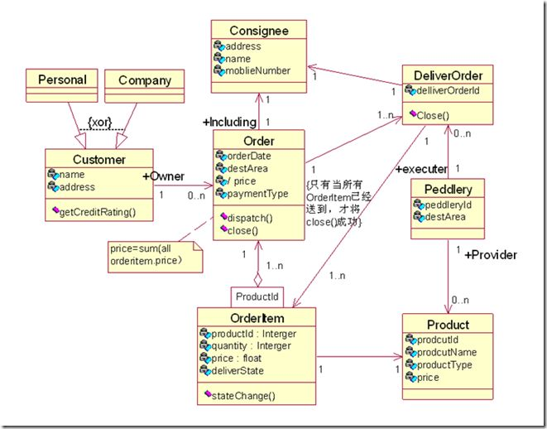
Next class
Software designer

